Slide 1

Carbon Capture: System vs. Material Innovation for Cost Reduction

Slide 2

A note about this e-book
Mukunda Kaushik
Associate Research Director
This e-book is an abridged version of our popular webinar “Carbon Capture: System Versus Material Innovation for Cost Reduction.”
For the full webinar, which provides more research and context, please visit our website here.

Slide 3
Key takeaways
Target carbon capture as the primary lever for reducing CCS costs.
Demand from data centers and new business models with biogenic CO₂ will spur innovation and technology-application tailoring.
Explore system benefits for the near term and monitor technologies with different first principles.
Emitters will opt for established solvent providers because of established market credibility. Novel materials with incremental benefits will face challenges in the long term.
Connect the dots: systems, materials, regulations, and byproducts.
Emitters will opt for established solvent providers because of established market credibility. Novel materials with incremental benefits will face challenges in the long term.

Slide 4




Carbon Capture: System vs. Material Innovation for Cost Reduction
PRODUCT DESIGN & INNOVATION
BRAND
Combine proven capture materials with system improvements before taking unnecessary technology risk.
Established market credibility will increasingly influence which capture technologies win commercial projects.
Carbon capture is becoming the critical cost-reduction frontier as transport and storage infrastructure matures.
SUPPLY CHAIN & OPERATIONS
GROWTH POTENTIAL
New materials may require investment in manufacturing capacity and entirely new supply chains.
Cement, natural gas power, and biogenic CO2 sources represent major growth markets for capture innovation.

Slide 5

Carbon capture is approaching a new innovation cycle
EXECUTIVE SUMMARY
Key takeaway: As storage infrastructure advances, attention will shift back to the cost and scalability of capturing CO₂.
Progress in transport and storage is removing one bottleneck from the CCS* value chain, but it is exposing another: point-source carbon capture remains expensive. At the same time, companies are becoming less willing to adopt unproven technologies without a clear path to scale.
Executives should focus on three priorities:
Improve near-term economics through system-level innovation and proven solvents.
Reserve higher-risk material bets for technologies capable of fundamentally changing capture economics.
Combine technology, infrastructure, policy, and potential revenue streams when evaluating the business case.
The next phase of carbon capture will reward commercially differentiated solutions, not innovation for its own sake.

Slide 6
Four forces are shaping carbon capture strategy
THE MARKET
Key takeaway: CCS adoption depends on more than technology performance. Policy, alternatives, infrastructure, and capture economics must align.
Companies are taking very different approaches to CCS because project economics vary significantly by market and application. Four factors increasingly determine the path forward:
Policy: Carbon pricing and incentives such as 45Q can materially affect project viability.
Competing options: Electrification, fuel switching, and other decarbonization pathways can displace CCS.
Infrastructure: CO₂ transport and storage must be both available and accessible.
Capture economics: Capture remains the most expensive part of the CCS value chain.
As storage infrastructure expands, the economics of point-source capture will increasingly become the constraint that determines whether capacity actually gets built.
Competing Options
Policy
Capture Economics
Infrastructure

Slide 7
Advanced amines improve economics, but not enough
MEA IMPROVEMENTS
Key takeaway: Novel amine solvents can reduce capture costs, but incremental material improvements alone are unlikely to transform project economics.
Advanced amines are already reaching commercial readiness, with some solutions operating at approximately 2.7 GJ per tonne of CO₂. Compared with baseline MEA, that lower energy requirement can reduce capture costs by roughly 12% to 17%.
At a 300 ktonne/year facility, Lux estimates costs can fall from:
USD 122 to USD 107/tonne for natural gas combined cycle
USD 131 to USD 111/tonne for waste-to-energy
USD 183 to USD 152/tonne for cement
The improvement is meaningful, but costs remain high, particularly for cement. For companies seeking deeper reductions, the next question is whether to continue improving the material or pair proven solvents with system-level innovation.
Levelized Cost of Capture: 300 ktonne/y
17%
12%
15%

Slide 8
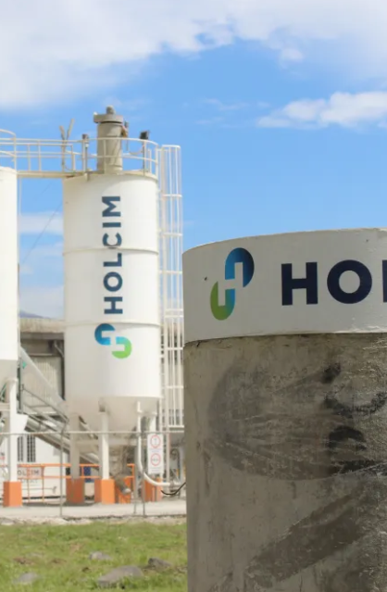

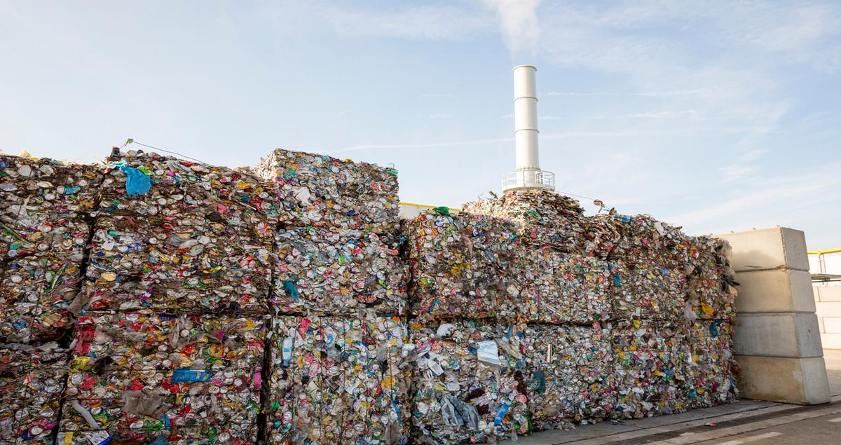
Three industries will lead the next wave of capture deployment
WHERE DEMAND WILL GROW
Key takeaway: Innovation should target industries where carbon capture is structurally necessary or capable of creating additional value.
Not every emitter will become a major CCS customer. Lux identifid three areas with especially strong adoption drivers over the next 10 to 15 years.
Cement: Process emissions make complete decarbonization through fuel switching difficult.
Natural gas power: Data-center growth could increase demand for low-carbon, dispatchable electricity.
Biogenic CO₂: Waste-to-energy, bioethanol, and biogas can potentially generate valuable carbon-removal credits.
Together, cement, power and heat, and biogenic CO₂ represent approximately 200 million tonnes of announced capacity over the coming decade.
The challenge is that each has different flue gas characteristics, operating scales, and capture economics.
Cement
Natural gas power
Biogenic CO₂

Slide 9
Current carbon capture economics leave little room for incrementalism
THE COST CHALLENGE
Key takeaway: Baseline capture costs remain high, particularly at smaller facilities and in processes with limited access to suitable heat.
MEA remains the benchmark for point-source capture. At a 1 million tonne-per-year facility, Lux estimates capture costs at approximately USD 90 to USD 160 per tonne of CO2, depending on the application.
Scale matters significantly. At roughly 300,000 tonnes per year, costs rise to approximately:
Natural gas combined cycle: USD 122/tonne
Waste-to-energy: USD 131/tonne
Cement: USD 183/tonne
Advanced amines already reduce energy requirements and can lower costs by roughly 10% to 15%, but costs generally remain above USD 100/tonne.
That leaves companies with two paths: improve the system or fundamentally improve the capture material.
Levelized Cost of Capture: 1 Mtonne/y with MEA solvent
*

Slide 10
Process intensification offers a practical near-term route to lower costs
SYSTEM INNOVATION
Key takeaway: For projects approaching commercialization, system improvements can deliver meaningful savings without requiring a new capture material.
Rotating packed beds illustrate the opportunity. By using centrifugal forces to improve contact between flue gas and solvent, they can reduce equipment size, land requirements, and operating costs.
Lux estimates that rotating packed beds can:
Reduce the capture unit’s capital cost by approximately 50%.
Shrink physical footprint.
Improve resource utilization.
Lower overall capture costs by approximately 25% to 30%.
At 300,000 tonnes per year, combining advanced amines with process intensification can push natural gas and waste-to-energy capture below USD 100/tonne.
For projects that need to operate before 2030, this matters more than theoretical long-term performance
Cost Reduction from RPBs:
300 ktonne/y with Amines
25%
27%

Slide 11
Better heat management can rival material innovation
SYSTEM INTEGRATION
Key takeaway: Optimizing heat integration can reduce one of the largest operating costs in solvent-based carbon capture.
Solvent regeneration is energy intensive, making steam one of the largest contributors to capture cost. Integrated heat recovery can capture otherwise wasted thermal energy and use it to reduce external steam requirements.
Lux’s analysis shows that better heat recovery can deliver approximately 20% to 30% cost reduction, with particularly significant benefits where steam costs are high.
The opportunity is application specific:
Waste heat must be available at the appropriate temperature.
Additional heat exchangers add infrastructure costs.
Solutions must integrate into broader engineering and EPC offerings.
System innovation therefore becomes most valuable when delivered as part of a comprehensive capture solution rather than as another standalone technology.
Cost Reduction (Heat Recovery):
300 ktonne/y with amines
26%
29%

Slide 12
New materials must beat the system-improvement benchmark
MATERIAL INNOVATION
Key takeaway: Incrementally better materials may struggle commercially if system improvements can deliver comparable savings with less technology risk.
System innovations can reduce levelized capture costs to approximately USD 90 to USD 100 per tonne in favorable cases. That creates an important benchmark for new materials.
Novel solvents operating around 2.0 to 2.7 GJ per tonne of CO2 can improve economics, but often only marginally compared with proven amines paired with system improvements.
For less-established developers, that creates a difficult proposition: asking an operator to accept additional technology and commercialization risk for perhaps only USD 5 to USD 10 per tonne in additional savings.
The stronger long-term opportunity lies with technologies built on differentiated first principles, particularly those targeting energy consumption below roughly 2 GJ per tonne.
Baseline (amines)

Slide 13



Breakthrough capture technologies must deliver step-change economics
NEXT-GENERATION MATERIALS
New innovation
Novel solvents
Baseline (amines)
Achieves better results for all applications

Slide 14

Connect the levers to build the carbon capture business case
THE OUTLOOK
Key takeaway: The winning strategy will combine system innovation, differentiated materials, policy support, and new sources of economic value.
Reducing technology cost is only one way to improve carbon capture economics. Some emerging approaches can create valuable byproducts or participate in new carbon-removal markets.
For executives, the implication is clear:
Prioritize system benefits for near-term projects.
Monitor differentiated, first-principles technologies for longer-term disruption.
Leverage established market positions and credibility.
Stack policy, byproduct, and carbon-credit value where applicable.
The strongest CCS strategies will connect these levers rather than evaluating technologies in isolation.

